Slide 1
Group J
Members
Names
-ES20BTECH11017
-ES20BTECH11006
-ES20BTECH11001
-ES20BTECH11029
-MS20BTECH11005
Roll no.
Lokesh surana
Ayush kumar Singh
Anish A
Thupten Dukpa
Naresh Avancha

Slide 2
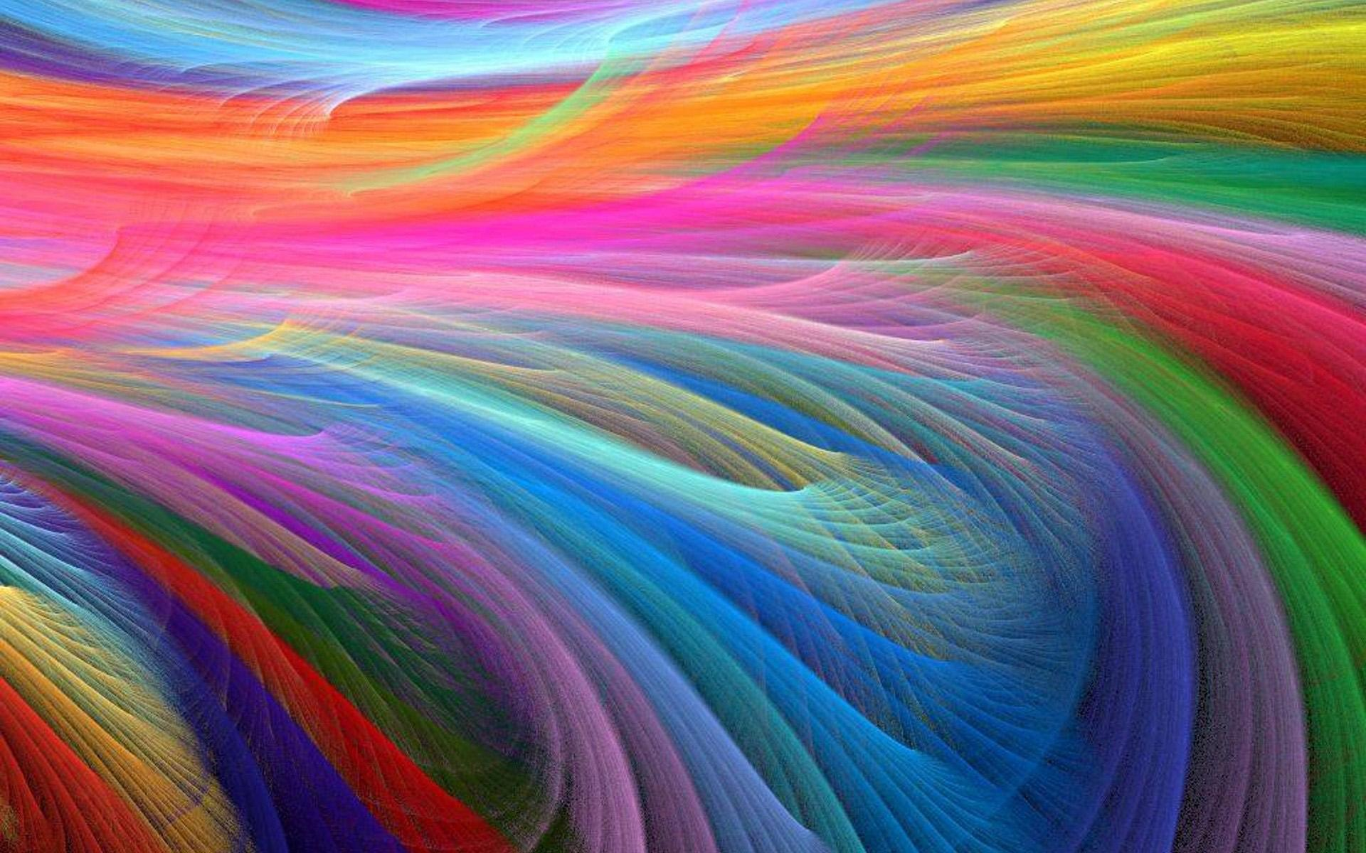
COLOUR CHANGING MATERIALS
Group J

Slide 3
Overview
Color and color changing materials
Introduction to structural colors
Morpho Butterfly - Excellent example
Chameleon - changes colour using specific structure
Biomimicry of these structures
Synthesis of nanocrystals and nanostructure
Creation of lattice
Vapochromic responses
Challenges and Vision

Slide 4
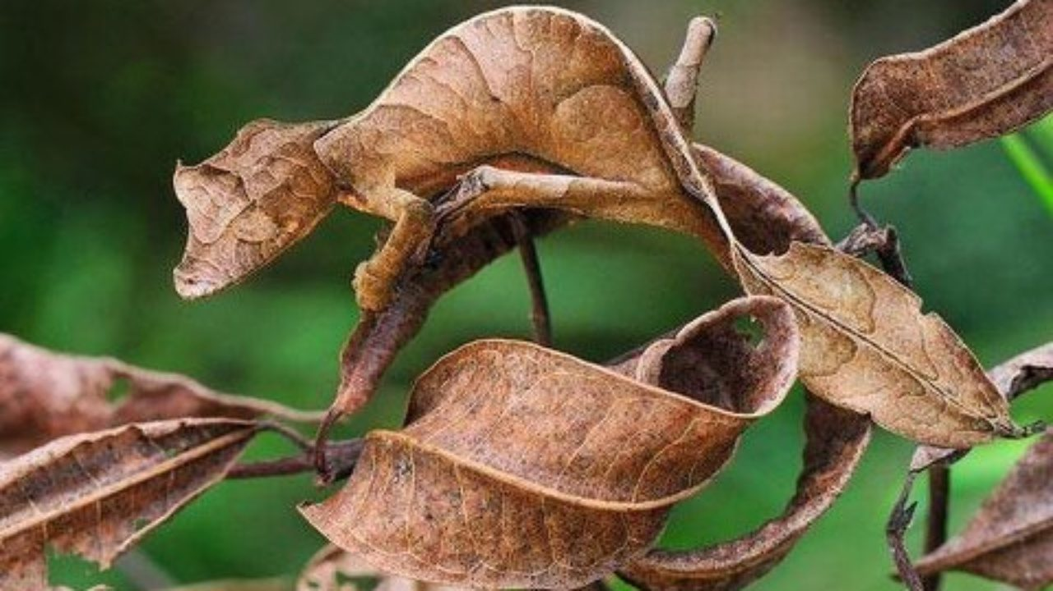
Why do we need a colour changing material?
To switchable camouflage and visors for military applications
Colour changing cosmetics and clothing
To find structural defects

Slide 5
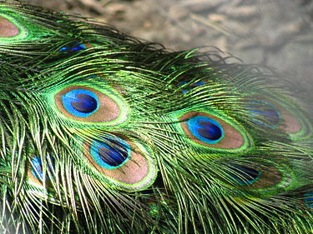
Structural Colours
Structural coloration is the production of colour by microscopically structured surfaces fine enough to interfere with visible light.
Structural colours have great potential for adaptive camouflage, biomimetic surfaces that could provide brilliant colours and many more.

Slide 6
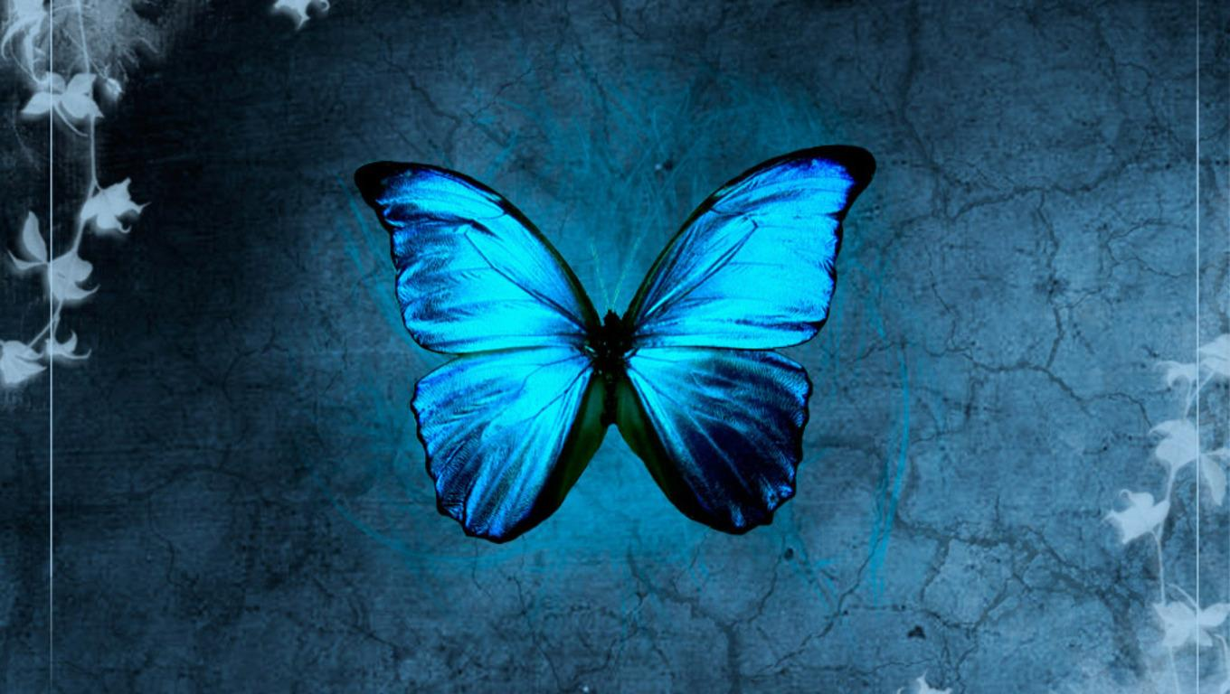
STRUCTURAL COLOURS IN BUTTERFLY WINGS

Slide 7
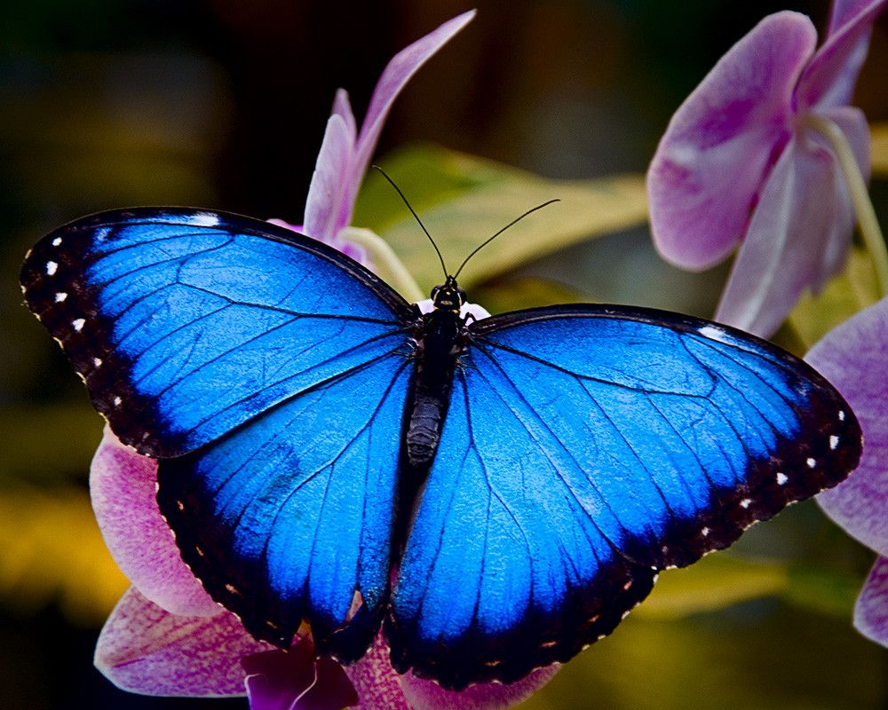
Structure of
Butterfly Wings
Made up of two chitinous layers.
Lined with minuscule ridges.
Ridges are protein structures.

Slide 8
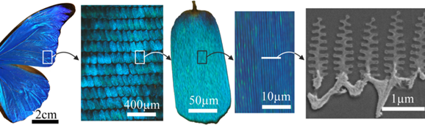
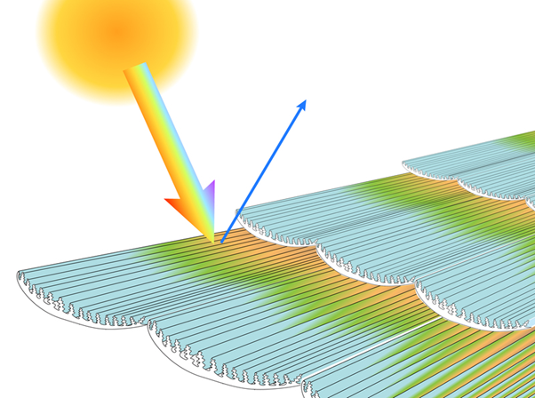
Structural Colours:
The Mechanism
The arrangement of ridges decides the colour of the wing.
Scaling law:
Height of Ridges < ½ Distance b/w them
Incident light gets diffracted by ridges.
Iridescent colour is produced by Interference and Diffraction.

Slide 9
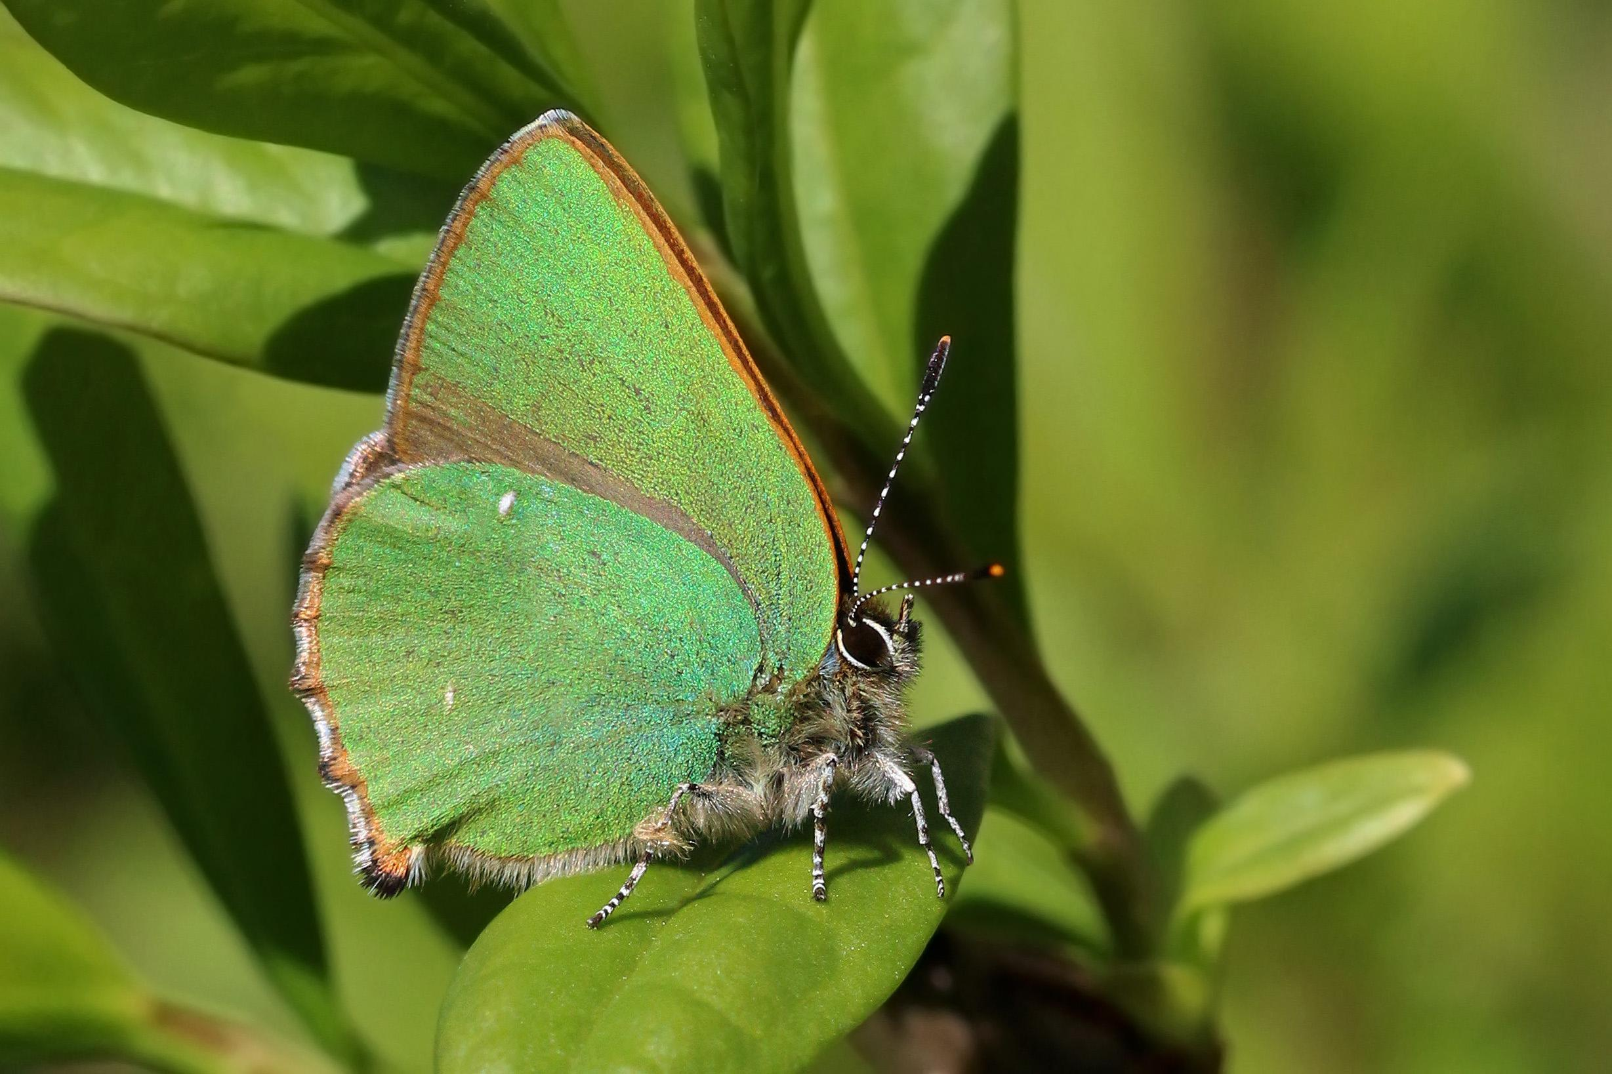
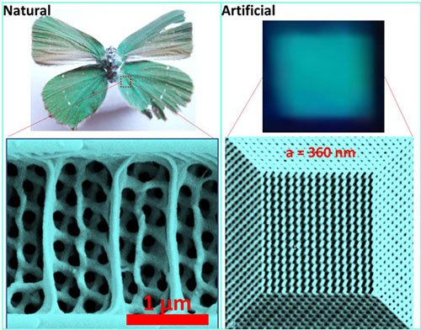
Ongoing Research
Researchers at Swinburne have managed to recreate gyroid structures found in the wings of the Green Hairstreak butterfly by using a special printing technique.

Slide 10
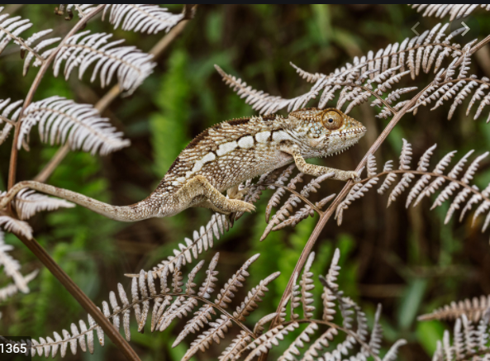
CHAMELEON

Slide 11
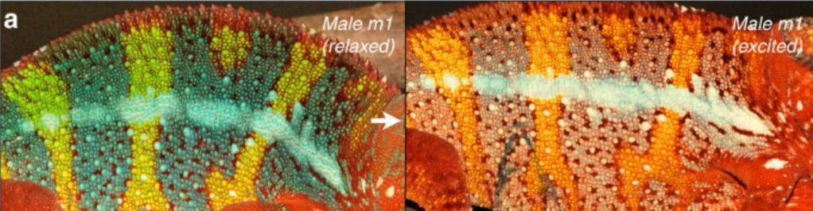
In skin of panther chameleon
Unlike other lizards, The skin of panther chameleons layer of iridophore cells along with pigments.
Iridophores reflect light using plates of nanocrystal guanine.

Slide 12
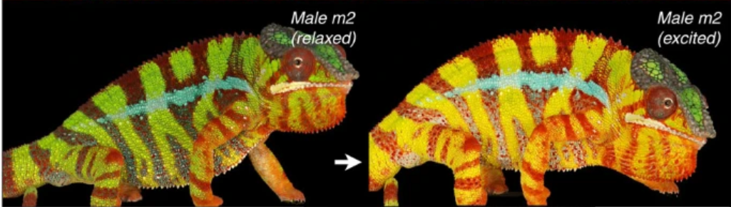
Colour change by adjusting spacing between these nanocrystals, which causes different wavelengths to be reflected as result of Bragg’s law.
Iridophores change the way we perceive pigment colour.

Slide 13
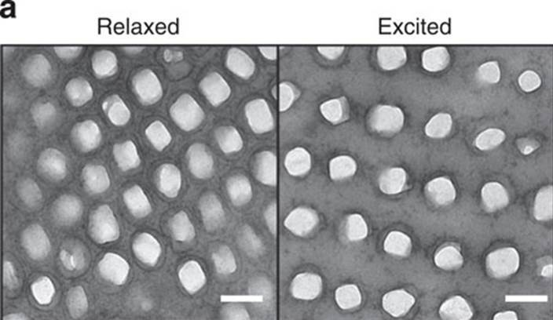
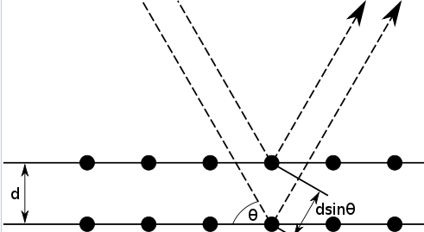
Bragg’s condition
Radiation get scattered by atoms of crystalline system
Wavelength of radiation should be comparable of atomic spacing
Scattered light should undergo constructive interference
2dsinθ = nλ - This is Bragg’s Law.

Slide 14
Approach to biomimic...
To create desired material on basis of structural colour -:
We need a crystalline lattice - can be done using NIL technique
Synthesizing crystals that would be at lattice points
To change spacing between planes of crystalline lattice - we are trying to achieve this using vaprochomic process

Slide 15
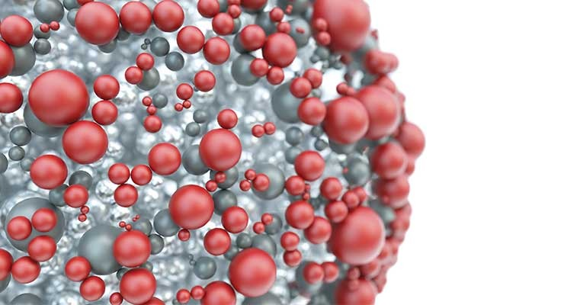
SYNTHESIS OF NANOPARTICLES

Slide 16
SYNTHESIS OF NANOPARTICLES
There are different methods to synthesis nanoparticles for the purpose of biomimicry.
These methods includes :
Mechanical milling
Laser ablation
Nucleation and growth
NIL(Nanoimprint Lithography)

Slide 17
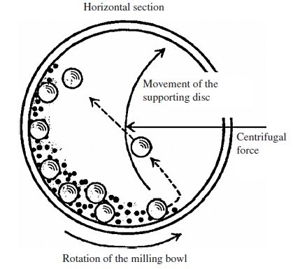
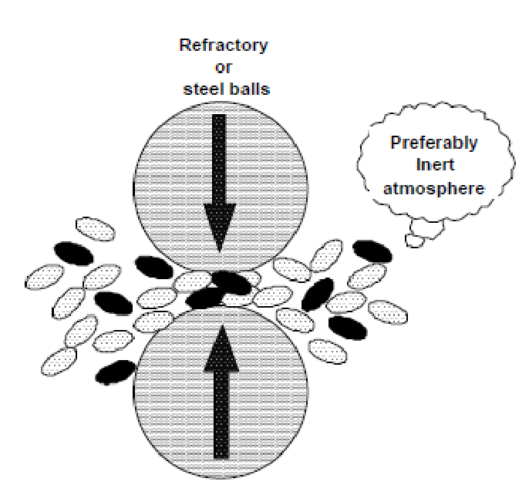
MECHANICAL MILLING
Nanoparticles in this process are made from top down method.
Nanoparticles are formed in a mechanical device (generally referred as mill) in which energy is imparted to a coarse grained material to affect resolution in particle size.

Slide 18
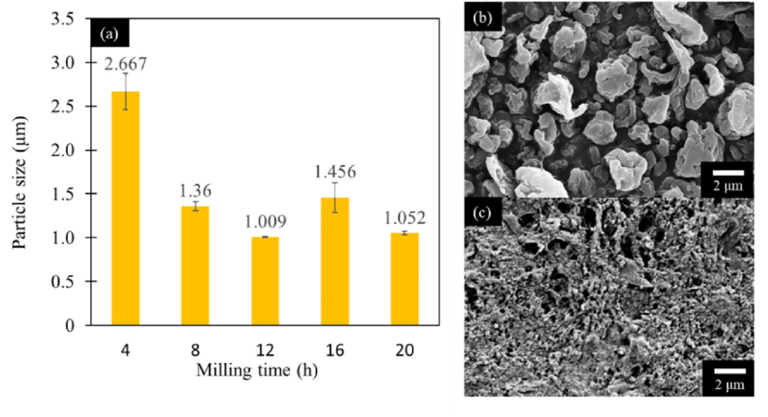
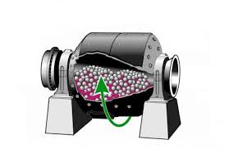
Ball mill

Slide 19
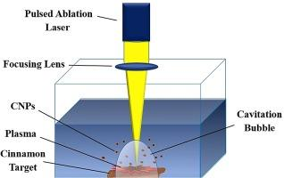
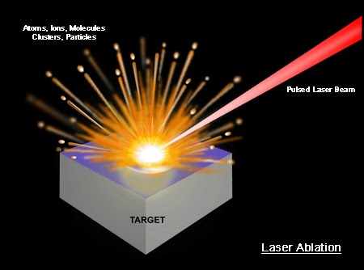
LASER ABLATION
Production of nanoparticles(NPs) by laser ablation involves ablating a solid target that lies in a gaseous or liquid environment.
Easy, straightforward and fast method for generation of nanoparticles compared to other methods. It does not require any hazardous chemicals and hence it is environmental friendly(green) method.

Slide 20
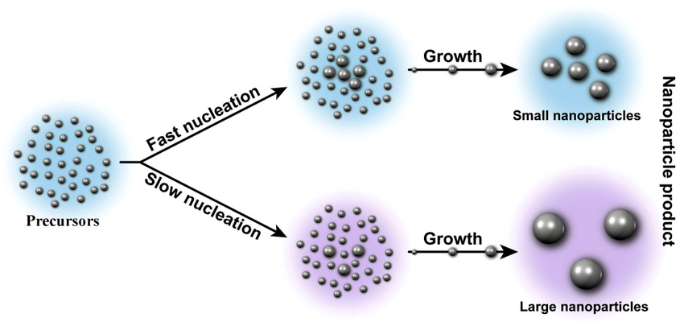
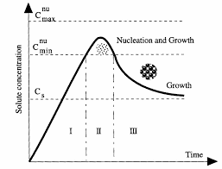
NUCLEATION AND GROWTH
Nucleation is a phenomenon of first formation of nanocrystals in solution.
It involves the appearance of very small particles or nuclei of new phase which are capable of growing.
LAMER’s diagram

Slide 21
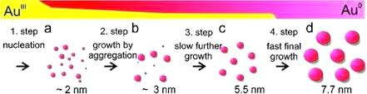
Typical precipitation process for nucleation:
Reactant 1 + Reactant 2 -----🡪 product + by product -------🡪Particles
stabilizer
nucleation
(critical size)

Slide 22
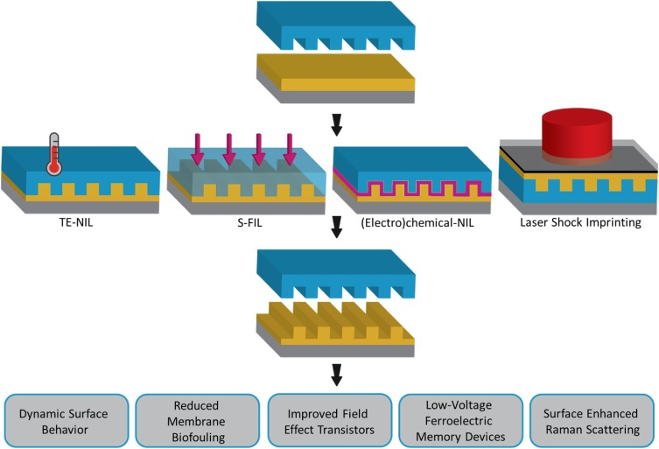
NANOIMPRINT LITHOGRAPHY
Nanoimprint lithography (NIL) is a method of fabricating nanometer scale patterns. It is a simple process with low cost, high throughput and high resolution. It creates patterns by mechanical deformation of imprint resist and subsequent processes.
There are different methods of NIL techniques:
Thermoplastic NIL
Photo NIL
Resist Free NIL

Slide 23
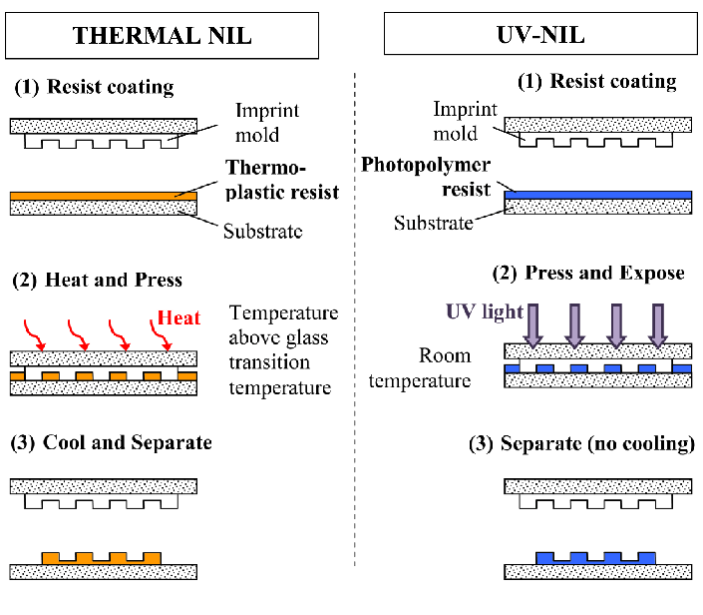

Slide 24
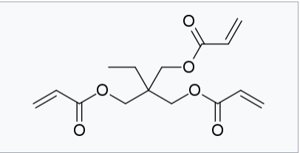
ARTIFICIAL POLYMER LATTICE

Slide 25
Highlights
Large-scale and crack-free inverse opal films with
brilliant colors are achieved
Polymer films with vapochromic responses.
Polymeric actuators which show fast color change alterations.

Slide 26
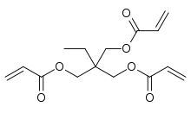
THE POLYMER
Taking advantage of the fast vapor-absorbing/desorbing capabilities of Poly Trimethylolpropane Triacrylate (PTMPTA), the inverse opal PTMPTA films can shift their colors vividly and extensively in a short time (shift of 37 nm(wavelength of the colour) in only 0.2 s).
Monomer of the polymer

Slide 27
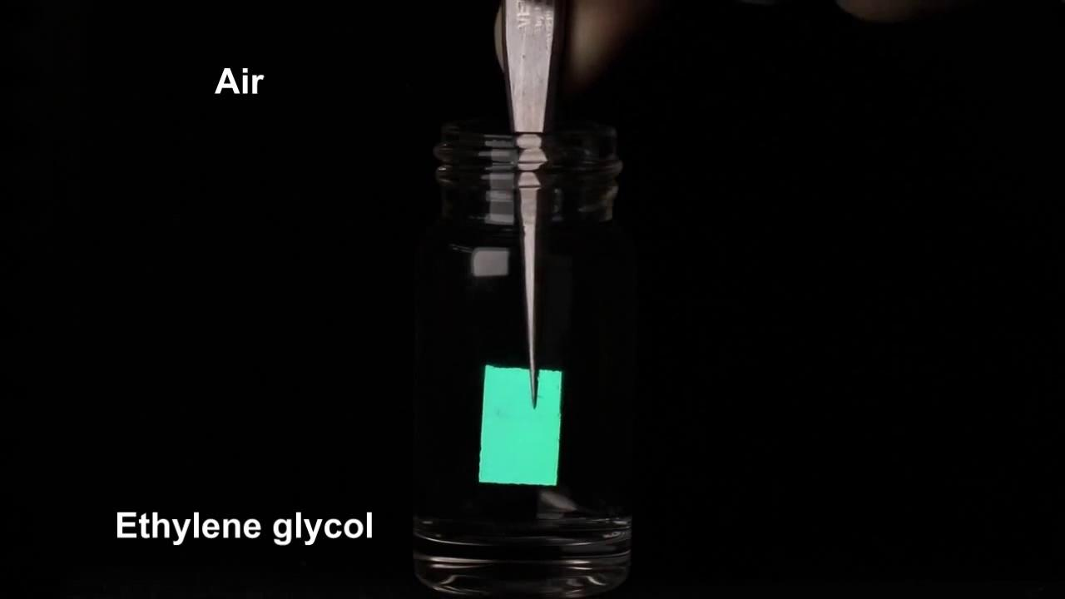
PTMPTA in different organic solvents

Slide 28
What is happening in the video??
Upon exposure to certain organic vapors, the organic molecules diffuse into the inverse opal films, causing the inverse opal film to swell and change its lattice spacing as well as the refractive index, thus red-shifting the Bragg diffraction.
With the removal of vapors the molecules can escape, leading to shrinkage of the inverse opal film and recovery of the Bragg diffraction.

Slide 29
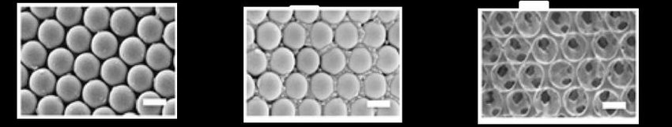
Inverse opal films
Before swelling
After swelling

Slide 30
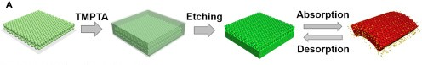
Fabrication of the polymer(PTMPTA)
Typically, the inverse opal-structured color films were fabricated by using highly ordered silica colloidal crystals as structural templates.

Slide 31
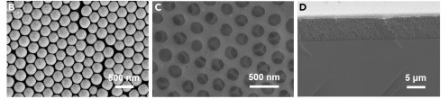
These colloidal crystal templates were firstly prepared via the self-assembly of silica particles on the surface of flat glass slides.
These self-assemble into closely and orderly packed colloidal crystal arrays as a result of solvent evaporation(Figure B)
Thereafter, the trimethylolpropane triacrylate (TMPTA) prepolymer solution was cast into the silica templates and then degassed in vacuum.(Figure C &D)

Slide 32
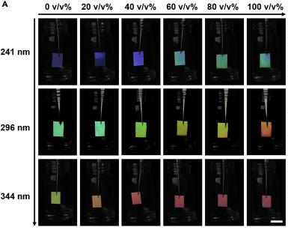
How can we get more variety of colours?
For an inverse opal template with a given silica particle size, the increased acetone concentration in the mixed solvent afforded an increase in color shift.

Slide 33
Visions
By introducing this polymer into the actuation systems, they could adapt to the environment by displaying specific colors.
On the basis of these inspiring demonstrations, various smart actuation systems with well-coordinated color alteration will be possible in future by integrating more intelligent functions (e.g., self-healing, self-adaptive) into the materials.

Slide 34
Challenges
We need a continuous supply of organic chemicals for the colour changes.
In prolonged usage the luminescence decreases and it does not change to the exact colour desired.
Due to continuous expanding and relaxing elastic hysteresis will come into play , which we are ignoring here.

Slide 35
References:
https://youtu.be/SQggDnScsvI
https://www.sciencedirect.com/
https://en.wikipedia.org/wiki/Nanoimprint_lithography
https://www.seeker.com/chameleon-like-material-changes-color-on-demand-1769606251.html
https://nptel.ac.in/courses/102/107/102107058/
https://www.microscopy-uk.org.uk/mag/artoct04/cbscales.html
Swinburne researchers mimic butterfly wing for compact new technology | Swinburne
On the multifunctionality of butterfly scales: a scaling law for the ridges of cover scales - PubMed (nih.gov)
What are butterfly wings made of? - Australian Butterfly Sanctuary (australianbutterflies.com)

Slide 36

THANK YOU

